Slide 1
Scrum REVIEW
xleeduc

Slide 2
outline
Definition

Slide 3
ScRUM is
METHODOLOGY
FRAMEWORK
MANDATORY
PRODUCTIVELY
CREATIVELY
SIMPLE PRODUCT
COMPLEX
PRODUCT

Slide 4
SCRUM
ROLES
EVENTS
ARTIFACTS
RULES
Notes:
Each component within the framework serves a specific purpose and is essential to Scrum’s success and usage.

Slide 5
Scrum theory
TRANSPARENCY
INSPECTION
ADAPTATION

Slide 6

SCRUM VALUES
Transparency
Ask/ Offer help
Inspection & Adaptation
Admit mistake
Change direction
Sprint
Product backlog & Sprint backlog
Sprint Retrospective
Sprint Review
Notes:
These five values are easy to remember, but it can be difficult to understand what they mean, how to apply them, and how to recognize them in teams and individuals.
Openness is essential when we are dealing with complexity and unpredictability.

Slide 7

Transparency
Impediment/ limitation
Undone work
Support other
Solve conflict
Inspection & Adaptation
Admit mistake
Change direction
Take new task
Time-box of Sprint
Team order Sprint Backlog
Retrospective
Notes:
Courage is essential in solving complex problems and growing high performing teams.

Slide 8






SCRUM VALUES
Transparency
Inspection
Scrum Events
Notes:
These five values are easy to remember, but it can be difficult to understand what they mean, how to apply them, and how to recognize them in teams and individuals.
Openness is essential when we are dealing with complexity and unpredictability.

Slide 9
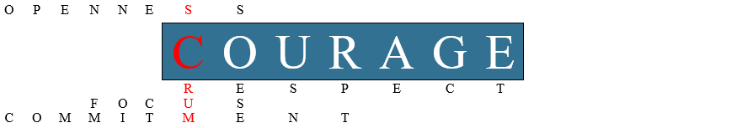
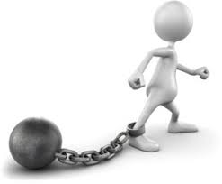
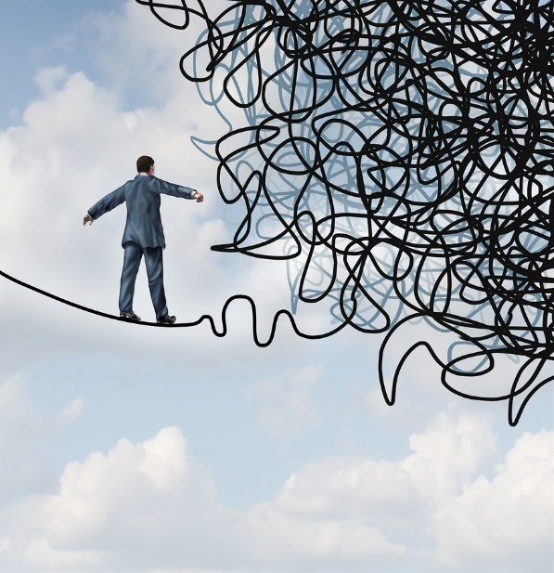
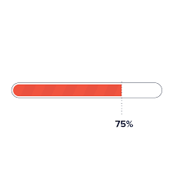
Sprint
Events
Time-box
High performance
Notes:
Courage is essential in solving complex problems and growing high performing teams.
Scrum
Time-box of Sprint
Team order Sprint Backlog
Retrospective

Slide 10
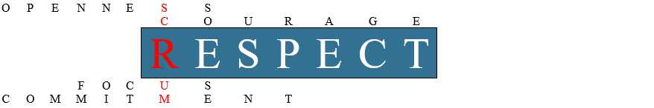

Scrum events
Self-organizing
Cross-functional
Development Team
Creative
Sprint backlog
owned by Development Team
Making decision
Increment
Notes:
Respect is essential in solving complex problems and growing high performing teams.

Slide 11





Sprint Goal
Time-box events
Roles
Backlog
Notes:
When we are dealing with complexity and unpredictability, focus is essential in order to get anything meaningful done.

Slide 12




Scrum Roles
Scrum Artifacts
Scrum Events
Notes:
Commitment is essential in solving complex problems and growing high performing teams
When we commit to delivering value, we feel a greater sense of shared purpose that drives our motivation to collaborate.

